Slide 1
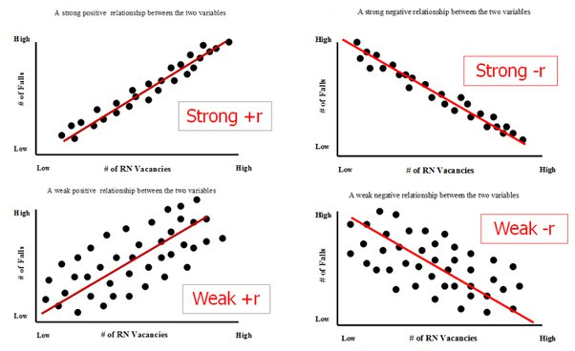
Lec # 9:Correlation in Regression

Slide 2
Last Lectures: Regression Modeling:
Simple linear regression modeling
Robustness in Linear regression and why? Outlier
Comparison of simple linear with robust linear model: R-Squared
Evaluation on anscomb.csv dataset
Polynomial Regression

Slide 3
Overview: Linear Regression:
Pearson Correlation Coefficient
Why we need to study Pearson coefficient
Determination Coefficient
A toy example of Pearson…
Modeling via Multi-variate Gaussian
Pymc practice on above concepts.

Slide 4
Motivation
Before multiple linear regression, how do we identify relationships among variables that may affect the model?

Slide 5
Motivation
How do we know if two variables are related?
Examples: study hours vs marks

Slide 6
Cont…
We need a way to measure relationship
Covariance ? −∞ to +∞
Correlation ? −1 and 1
Why is this useful before multiple linear regression?

Slide 7
Pearson correlation coefficient
Provide Measure: degree of (linear) dependence between two variables
Linear dependence: means how the variation of one variable impacts the other?
Denoted by r
r values: Range within the interval [-1, 1]
Why?: The Pearson correlation coefficient is used in linear regression to measure the strength and direction of the linear relationship between two variables, helping assess their suitability for modeling a linear regression relationship

Slide 8
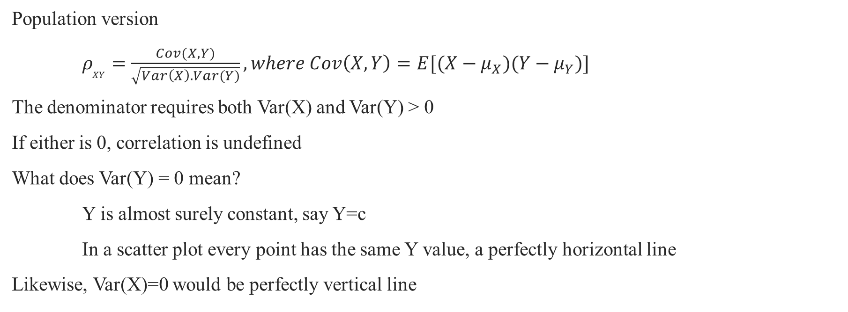
Correlation

Slide 9
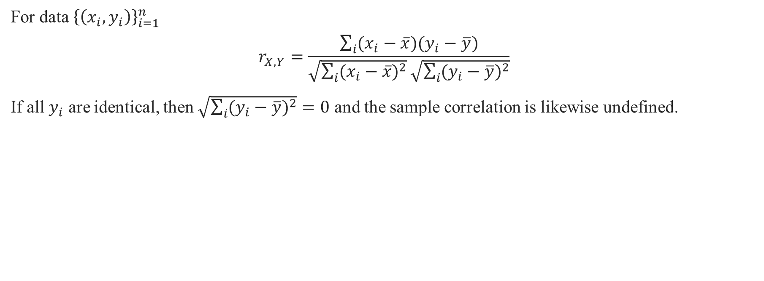
Sample correlation

Slide 10
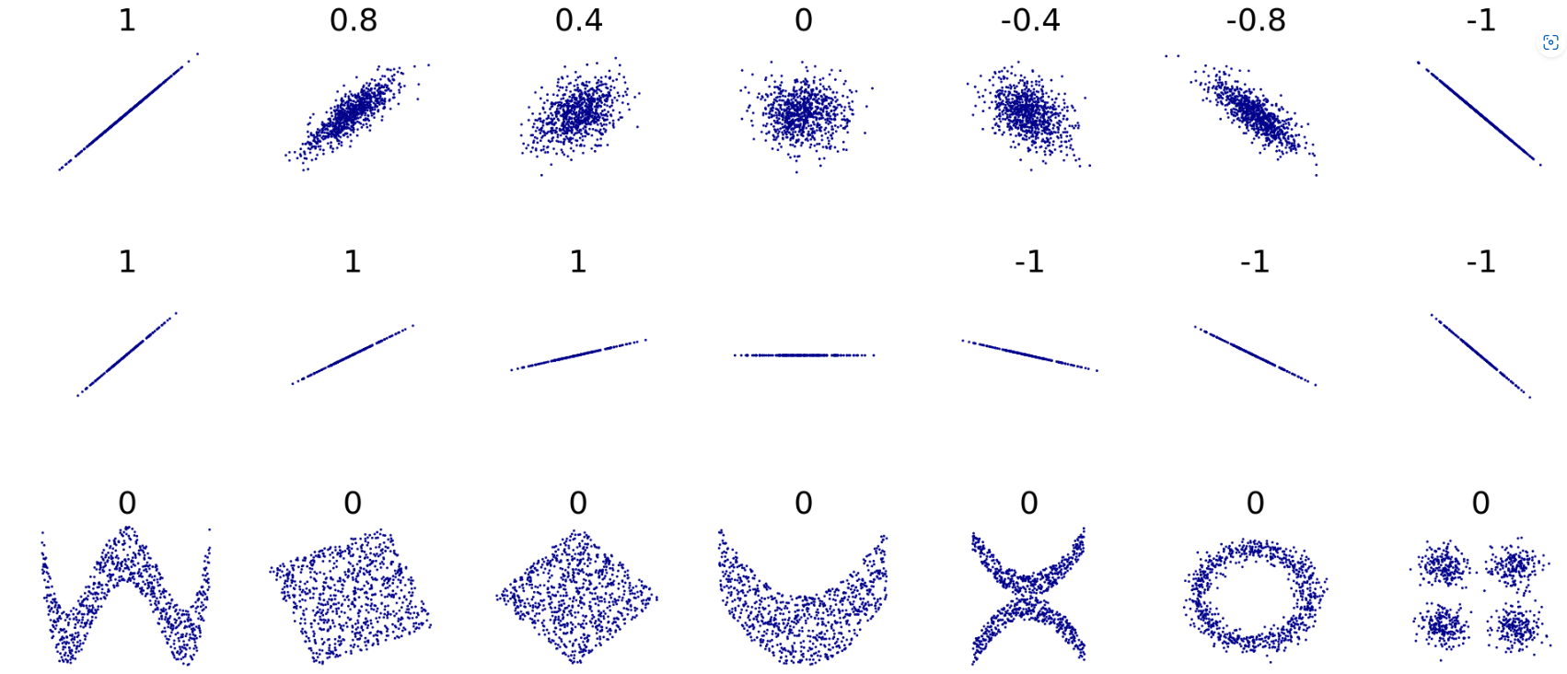
Pearson correlation coefficient
Simple Linear regression sometime leads to auto correlation problem:
Example:
r = 1: perfect positive Linear Relation
r =-1: perfect negative Linear relation
r=0 : No relation
Symmetry in data will always result in r=0.

Slide 11
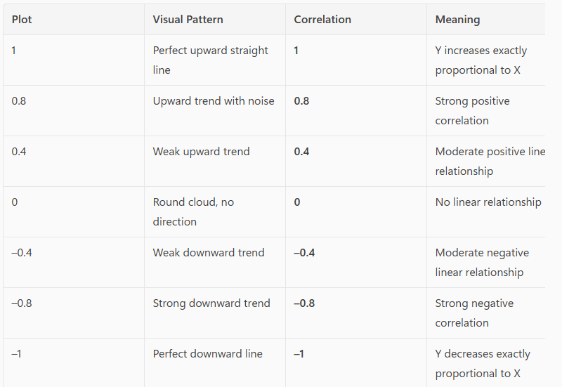
Row 1:
Linear relationships with different levels of noise
Direction matters
Positive = upward
Negative = downward
Strength (closeness to a straight line)
Tighter cluster -> correlation moves to +-1
More spread -> moves towards 0
0 is not random
Simply means no upward or downward trend
The data may have structure
You just can’t see it

Slide 12
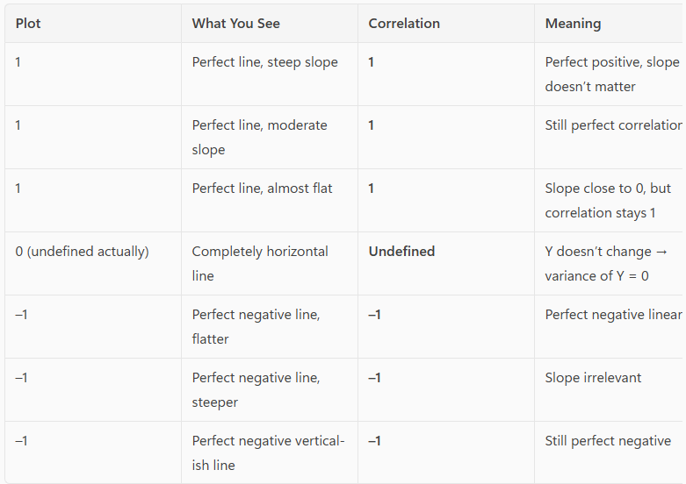
Row 2:
Linear but with different slopes, including special cases
Shows:
Perfect correlation
Different slopes
Undefined cases
Correlation ignores slope
Only looks at:
Do points lie on a straight line?
Is it upward or downward?
Undefined case (When Y is a constant):
Variance of Y=0
The correlation formula divides by 0

Slide 13
What it does and does not measure?
Does measure:
direction (positive or negative)
linearity (how well points fit a straight line)
Does not measure:
curve shape
strength of nonlinear relationships
symmetry
circular or periodic relationships
the slope of the line
whether X causes Y
That’s why some of the row bottom shapes in the previous slide look structured but still have correlation 0.

Slide 14
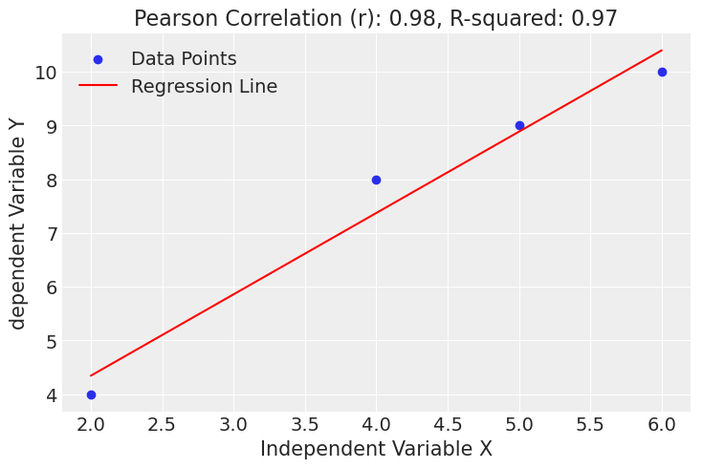
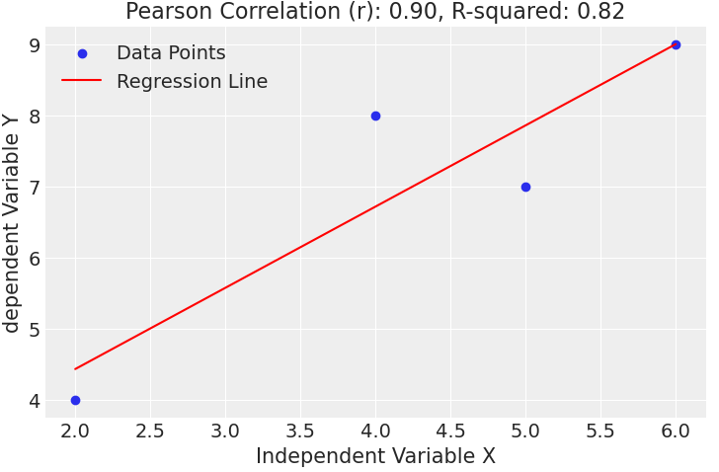
Determination coefficient
R-squared refer to: proportion of the variance in the dependent variable that is predicted from the independent variable.
The determination coefficient (R-squared) measures the proportion of the variance in the dependent variable that can be explained by the independent variable(s) in a regression model
x= [2,4,5,6], y= [4,8,9,10] x= same , y= [4,8,7,9]

Slide 15
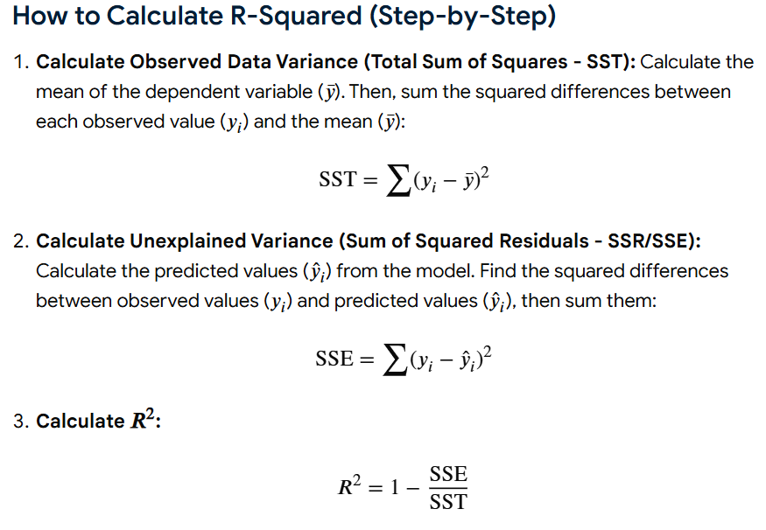
Calculate the R-squared

Slide 16

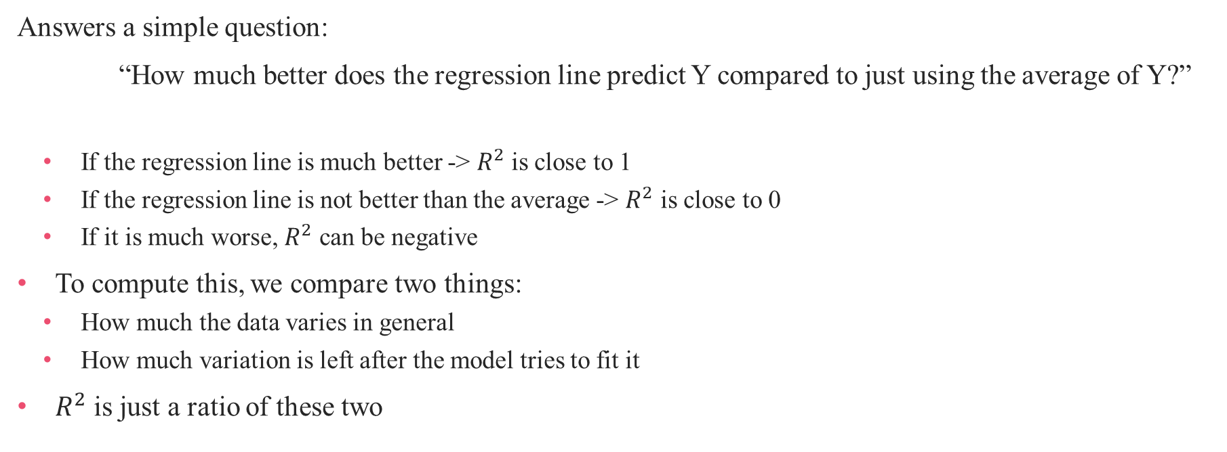

Slide 17
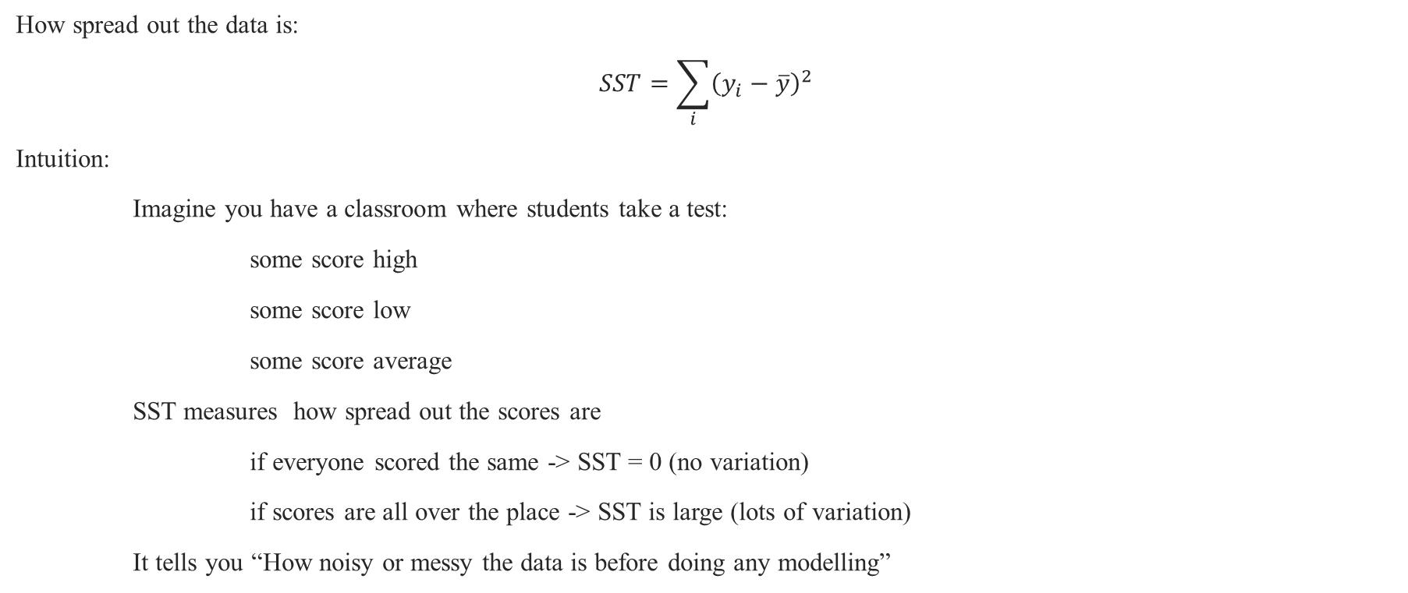
SST – Total variation

Slide 18
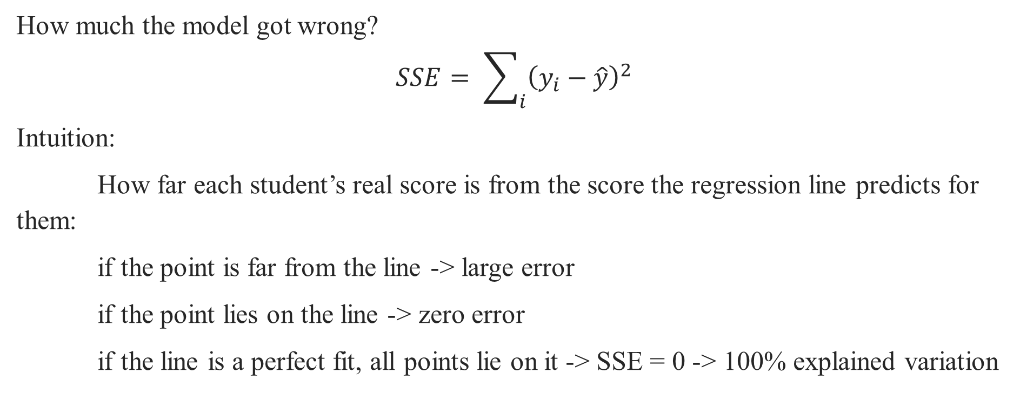
SSE – Unexplained variation

Slide 19

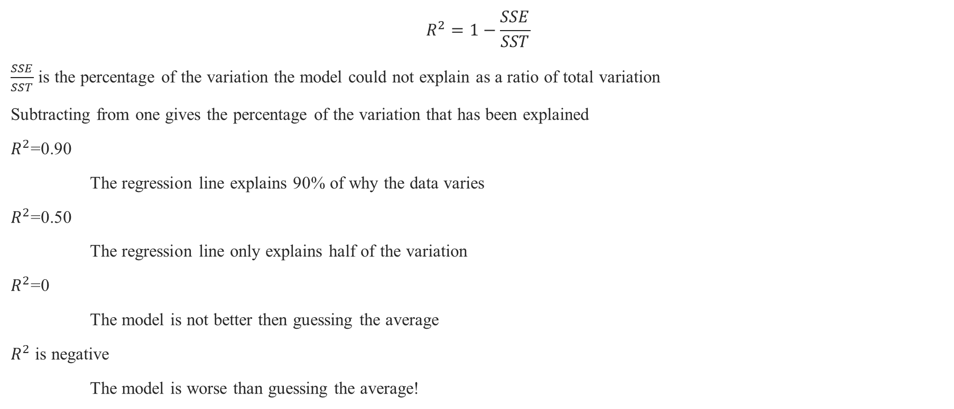

Slide 20
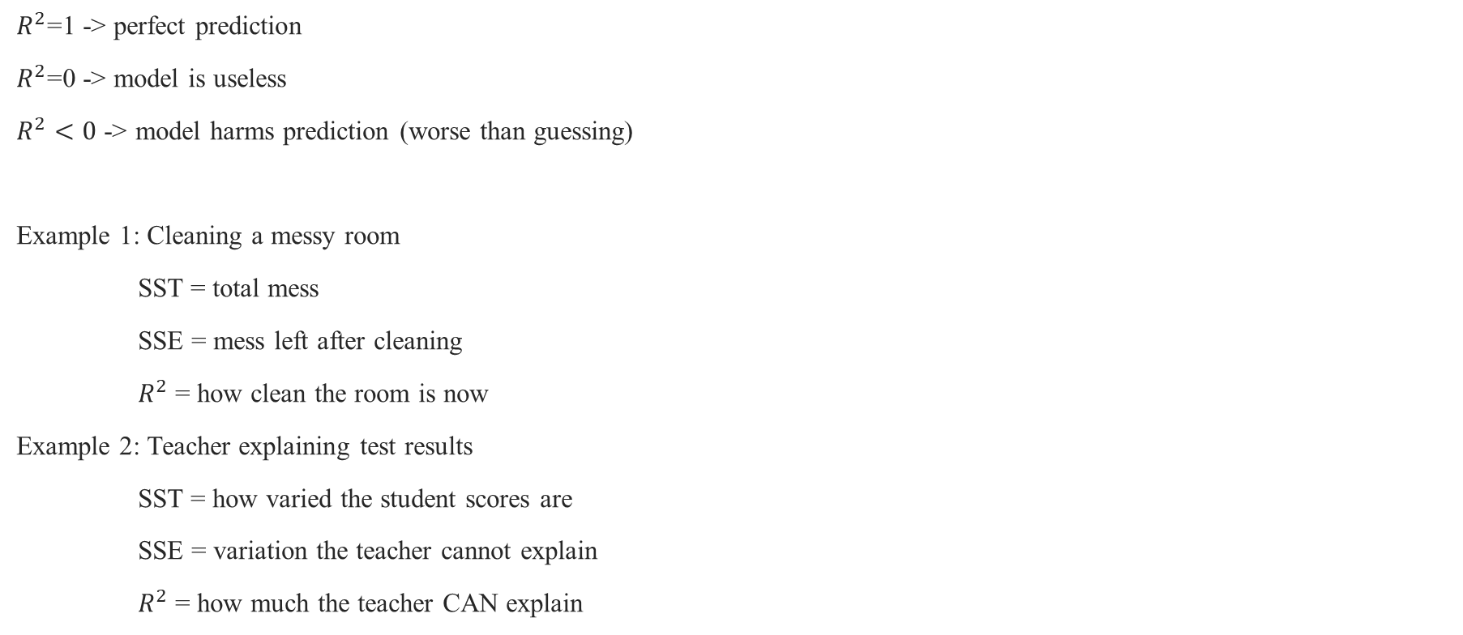

Slide 21

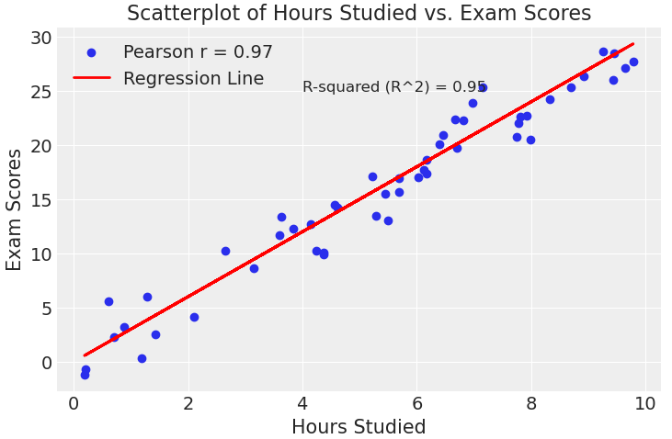
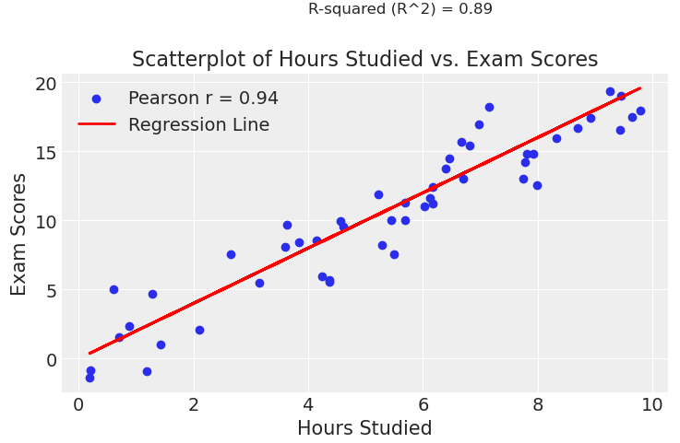
Determination coefficient
R-squared refer to: proportion of the variance in the dependent variable that is predicted from the independent variable.
Regression
Models
Pymc

Slide 22
Pearson & Determination coefficient
Values ranges and interpretation:
The Pearson correlation coefficient (r) ranges from -1 to 1, where:
r = 1 indicates a perfect positive linear relationship.
r = -1 indicates a perfect negative linear relationship.
r = 0 indicates no linear relationship.
R-squared (R^2) ranges from 0 to 1, representing the proportion of variance in the dependent variable explained by the independent variable(s) in a linear regression model. Another word a measure to test the fit of the regression line
Regression
Models
Pymc

Slide 23
Pearson correlation coefficient
A toy Example: Assume we have data,
X: [1, 2, 3, 4, 5]
Y: [2, 3, 4, 5, 6]
First, calculate the means (average) of X and Y
Mean(X) = (1 + 2 + 3 + 4 + 5) / 5 = 3
Mean(Y) = (2 + 3 + 4 + 5 + 6) / 5 = 4
Next, calculate the covariance between X and Y using the formula
Cov(X, Y) = Σ[(X - Mean(X)) * (Y - Mean(Y))] / (n - 1)
Cov(X, Y) = 2.5
Next, we need std
σ(X) = √[Σ(X - Mean(X))^2 / (n - 1)] & σ(Y) = √[Σ(Y - Mean(Y))^2 / (n - 1)]
Regression
Models
Pymc

Slide 24
Pearson correlation coefficient
Cov(X, Y) = 2.5
σ(X) = √(2.4532) ≈ 1.58 & σ(Y) = √(2.5332) ≈ 1.58
ρ(X, Y) = Cov(X, Y) / (σ(X) * σ(Y))
ρ(X, Y) = 2.5 / (1.58 * 1.58)
ρ(X, Y) ≈ 1
So, in this toy example, the Pearson correlation coefficient between X and Y is approximately 1, indicating a positive linear relationship between the two variables.
Regression
Models
Pymc

Slide 25
Example: Assume we have data,
X: [1, 2, 3, 4, 5]
Y: [2, 3, 4, 5, 6]
Step 1: Calculate Means (Averages):
Mean(X) = 3
Mean(Y) = 4
Step 2: Calculate :
Var(X) = 2.5
Var(Y) = 2.5
Cov(X, Y) = 2.5
σ(X) = √Var(X) ≈ 1.58
σ(Y) = √Var(Y) ≈ 1.58
Pearson correlation coefficient
Regression
Models
Pymc

Slide 26
Pearson correlation coefficient
Step 3: Calculate Pearson Correlation Coefficient:
ρ(X, Y) = Cov(X, Y) / (σ(X) * σ(Y))
ρ(X, Y) = 2.5 / (1.58 * 1.58)
ρ(X, Y) ≈ 1 (positive linear relationship)
Regression
Models
Pymc

Slide 27
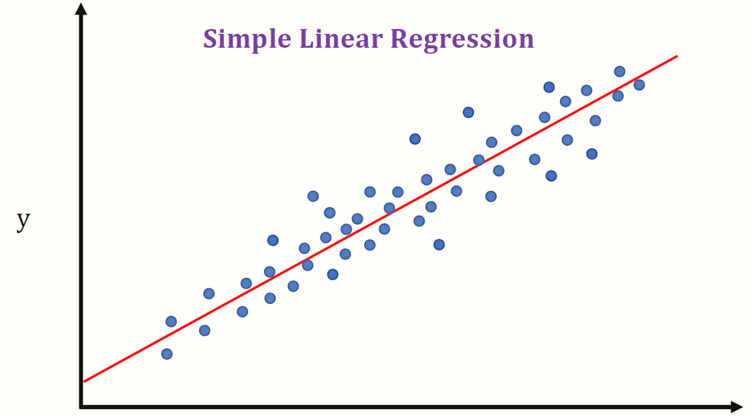
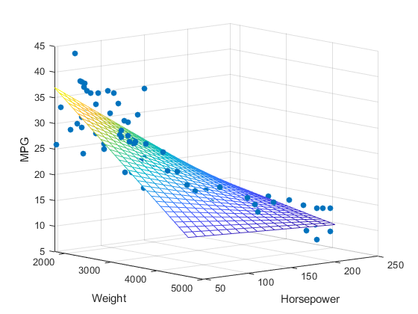

How can we check ?
Example:
Simple Linear Regression
Multiple linear Regression
X | y
X₁ | X₂ | y
Pearson correlation Coefficient
Regression
Models
Pymc3

Slide 28
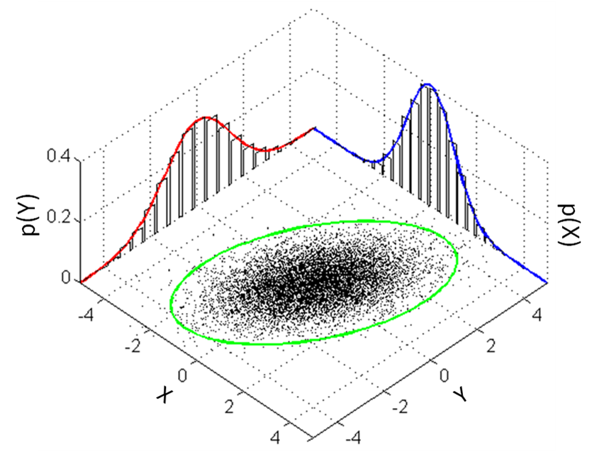
Understanding Multi-Variate Gaussian Distributions
Simple Linear regression sometime leads to auto correlation problem:
Multivariate Gaussian Distribution: A probability distribution that describes the joint behavior of multiple variables
Example: Imagine multiple measurements (e.g., height, weight) for a group of people. The multivariate Gaussian helps describe how these measurements relate and vary together.
Regression
Models
Pymc

Slide 29
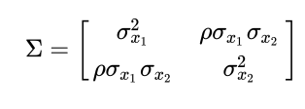
Co-variance Matrix
Understanding Covariance Matrix
Co-variance matrix represents, how the variables are related and their joint behavior
Diagonal Elements: Represent variances of individual variables
Off-Diagonal Elements: Show how variables relate to each other (positive, negative, or no relation).
Usefulness: Helps analyze relationships in data, used in finance, data analysis, and machine learning
The covariance matrix is essential for defining the multivariate Gaussian distribution's shape and relationships between its variables
Regression
Models
Pymc

Slide 30
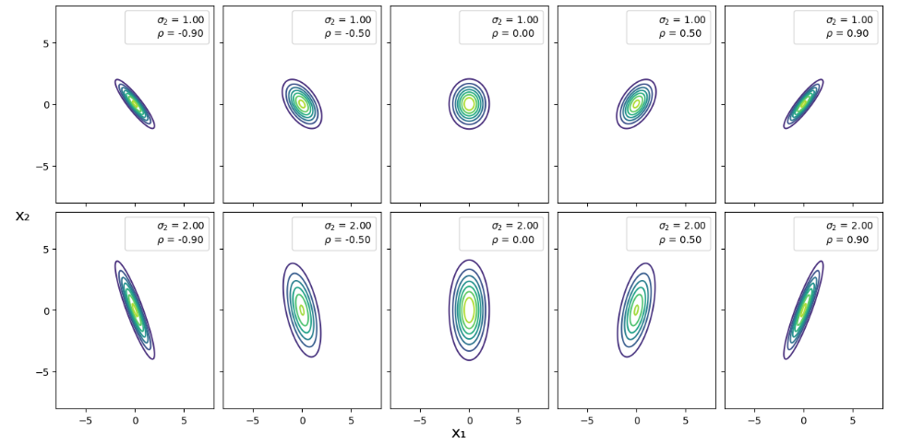
How Correlation and Variance Shape the Joint Distribution

Slide 31
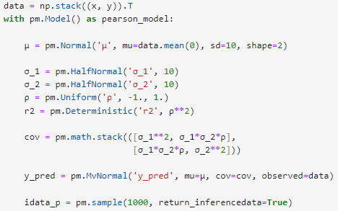
How to model the Pearson correlation
In Comparison to gaussian model what’s new in
this model?
Deterministic Variable for r²
Estimation Cov- Matrix
Likelihood
Regression
Models
Pymc

Slide 32


How to model the Pearson correlation
In Comparison to gaussian model what’s new in
this model?
Multi-Variate Gaussian Model
mu ∼ Uniform
sigma ∼ Half Normal
.
.
Co-vaMatrix
Likelihood ∼ MvNormal
Data
Synthetic Data
P-Coeficient
?
Regression
Models
Pymc3

Slide 33
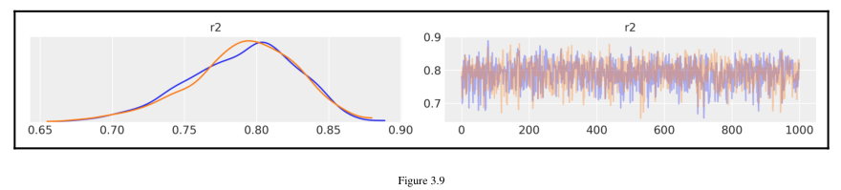
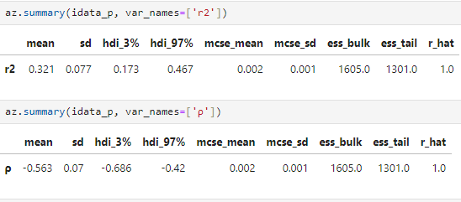
How to model the Pearson correlation
Posterior summary
R² = 0.79
Which denotes performance of model
Can vary
Regression
Models
Pymc3

Slide 34
Simple Linear Regression:
Types of regressions
In statistical modeling how can we model it
Correlation problem in Linear Regression
How to address correlation problem
Summarizing posterior of Linear Model
Plotting slope and intercept
Posterior predictive Checks(PPC) of slope and intercept
Comparison of 50% and 94% HDI of future data/ simulated data
Pearson Correlation Coefficient
Why we need to study Pearson coefficient
A toy example of Pearson…
Determination Coefficient
Modeling via Multi-variate Gaussian
Pymc practice on above concepts.
Regression
Models
Pymc3

Slide 35

Let's do it in pymc

